Slide 1

IEEE TRANSACTIONS ON ULTRASONICS, FERROELECTRICS, AND FREQUENCY CONTROL, VOL. 65, NO. 7, JULY 2018
Ultrafast imaging in biomedical ultrasound
Reporter: Renxin Zhuang

Slide 2

Outline
Review(2014)
Coherent Plane-Wave Compounding for Very High Frame Rate Ultrasonography and Transient Elastography(2009)
Ultrafast Ultrasound Imaging Using Combined Transmissions With Cross-Coherence-Based Reconstruction(2018)
Ultrafast Ultrasound Imaging With Cascaded Dual-Polarity Waves(2018)

Slide 3
Review
What is ultrafast: typically over 1000frames per second(fps)
Ultrafast imaging is obtained by transmitting a wide field-of-view beam(i.e.plane wave) which can scan in a single transmit event over the whole region of interest.
For example, suppose the speed of ultrasound is 1540m/s and the exploration depth is 15cm, then the frame rate is computed as 1540/(0.15*2), which is over 5000fps

Slide 4
Review
The development of ultrafast imaging(1970s-now)
In 1977, the ultrafast terminology is first coined in a seminal paper entitled “Ultrafast echotomographics system using optical processing of ultrasonic signals” by Bruneel et al.
In 1979, Delannoy et al. demonstrated the power of using receiving electronics with analog parallel processing instead of using an optical system.
Years after that, Shattuck et al. implemented a parallel processing approach which enabled the simultaneous acquisition of several B-mode lines. Their first system can process in parallel 4 ultrasonic beams in the receive mode and thus increase the data acquisition rate four times.
[1] c. Bruneel, r. Torguet, K. M. rouvaen, E. Bridoux, and B. nongaillard, “Ultrafast echotomographic system using optical processing of ultrasonic signals,” Appl. Phys. Lett., vol. 30, no. 8, pp. 371–373, 1977.
[2] B. delannoy, r. Torguet, c. Bruneel, E. Bridoux, J. M. rouaven, and H. lasota, “acoustical image reconstruction in parallel-processing analog electronic systems,” J. Appl. Phys., vol. 50, no. 5, pp. 3153–3159, 1979.
[3] d. shattuck, M. Weinshenker, s. smith, and o. von ramm “Explososcan: a parallel processing technique for high speed ultrasound imaging with linear phased arrays,” J. Acoust. Soc. Am., vol. 75, no. 4, pp. 1273–1282, apr. 1984.

Slide 5
Review
The development of ultrafast imaging(1970s-now)
From 1980s to 2000s, Fink's research group demonstrated that the concept of plane-wave illuminations and massive parallel receive beamforming could lead to ultrafast frame rates that were higher than a thousand fps.
In 2002, Tanter, one member of Fink's group, introduced plane-wave compounding, which includes transmission of tilted plane waves with different angles. This is termed incoherent plane-wave compounding.
Based on the idea of virtual dynamic transmit focusing, Montaldo, also one member of Fink's group, experimentally applied this concept of coherent summation of virtual dynamic transmit focusing to plane-wave transmissions, which ultimately resulted in coherent plane-wave compounding in 2009(CPWC).
[1] J. Bercoﬀ, s. chaﬀai, M. Tanter, l. sandrin, s. catheline, M. Fink, J. l. Gennisson, and M. Meunier, “In vivo breast tumor detection using transient elastography,” Ultrasound Med. Biol., vol. 29, no. 10, pp. 1387–1396, 2003.
[2] M. Tanter, J. Bercoﬀ, l. sandrin, and M. Fink, “Ultrafast compound imaging for 2-d motion vector estimation: application to transient elastography,” IEEE Trans. Ultrason. Ferroelectr. Freq. Control, vol. 49, no. 10, pp. 1363–1374, 2002.
[3] G. Montaldo, M. Tanter, J. Bercoﬀ, n. Benech, and M. Fink, “coherent plane-wave compounding for very high frame rate ultrasonography and transient elastography,” IEEE Trans. Ultrason. Ferroelectr. Freq. Control, vol. 56, no. 3, pp. 489–506, 2009.

Slide 6
Review
The development of ultrafast imaging(1970s-now)
Parallel to the representative work of CPWC that transmits plane-waves, another prevalant approach called synthetic aperture imaging(SA) , which transmits spherical waves, was proposed by the research groups of Jensen and Lockwood.
SA is based on single element transmissions and synthetic recombination of backscattered echoes, so it is not applied to ultrafast imaging because the number of transmit event is similar to that of conventional line-per-line focusing.
To increase the frame rate of SA imaging, sparse synthetic aperture imaging was proposed but it suffers from low SNR. For this reason, Lockwood et al. simulated sub-aperture made of several elements which generated a diverging wave. In this way, it only requires a few emissions, resulting in a compromise between ultrafast imaging and SA imaging.
[1] s. I. nikolov and J. a. Jensen, “In-vivo synthetic aperture ﬂow imaging in medical ultrasound,” IEEE Trans. Ultrason. Ferroelectr. Freq. Control, vol. 50, no. 7, pp. 848–856, 2003.
[2] G. r. lockwood, J. r. Talman, and s. s. Brunke, “real-time 3d ultrasound imaging using sparse synthetic aperture beamforming,” IEEE Trans. Ultrason. Ferroelectr. Freq. Control, vol. 45, no. 4, pp. 980–988, 1998.
[3] s. I. nikolov and J. a. Jensen, “Virtual ultrasound sources in highresolution ultrasound imaging,” in Proc. SPIE, 2002, vol. 3, pp. 395–405.

Slide 7
Review
The development of ultrafast imaging(1970s-now)
Ultrafast plane-wave imaging has been employed in the first ultrafast clinical scanner, the Aixplorer system, since 2008.
Other devices, such as the Verasonics platform, have been commercialized for use in academic research labs.

Slide 8
Coherent Plane-Wave Compounding
Difference between plane-wave imaging and conventional imaging with focused beam
In conventional imaging, both transmit focusing and receive focusing are present.
In single plane-wave imaging, there is only focusing in the reveive mode. So the quality of the image is degraded in terms of contrast and resolution.

Slide 9
Coherent Plane-Wave Compounding
Difference between single plane-wave imaging and coherent plane wave compounding
Coherent compounding of ultrasonic images acquired with different plane waves at tilted angles virtually rebuild the transmit focusing process for conventional imaging.
Note that the compounding is produced without taking the envelope of the beamformed signals or any other nonlinear procedure to ensure a coherent addition.
relying on dynamic focusing in both transmit and receive modes, this coherent compounding process allowed for better image quality in plane-wave compounding compared with conventional ultrasound without compromising the ultrafast frame rate.(Fig. 1)

Slide 10
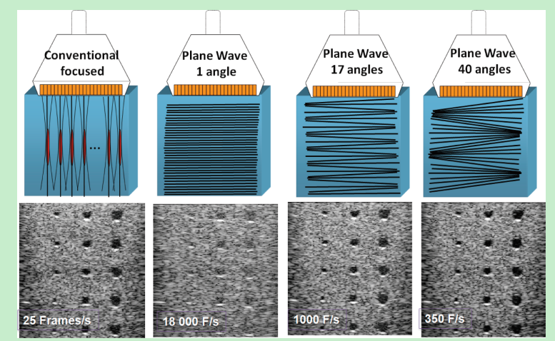
Coherent Plane-Wave Compounding
Fig. 1. conventional focused and ultrafast ultrasound imaging sequences for a typical medical imaging setup (4-cm deep region of interest): (a)
conventional focused imaging (128 focused beams and 4 focal depths leading to ~25 fps), (b) plane-wave imaging (~18000 fps), (c) plane-wave compounding with 17 angles (~1000 fps), and (d) plane-wave compounding with 40 angles (~350 fps).

Slide 11
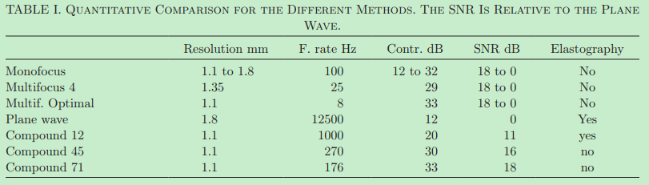
Coherent Plane-Wave Compounding
Theoretically, to obtain the same focusing quality as the optimal multifocus with 12 focal depths, it requires 71 plane waves insonifications.
Experimentally, Table I summarizes the comparison between different imaging methods.
We demonstrated here that the coherent compounding approach performs as well as the optimal multifocus image but with a signifcantly higher frame rate.

Slide 12
Combined Transmissions With Cross-Coherence-Based Reconstruction
Theoretically, to obtain the same focusing quality as the optimal multifocus with 12 focal depths, it requires 71 plane waves insonifications.
Experimentally, Table I summarizes the comparison between different imaging methods.
We demonstrated here that the coherent compounding approach performs as well as the optimal multifocus image but with a signifcantly higher frame rate.

Slide 13
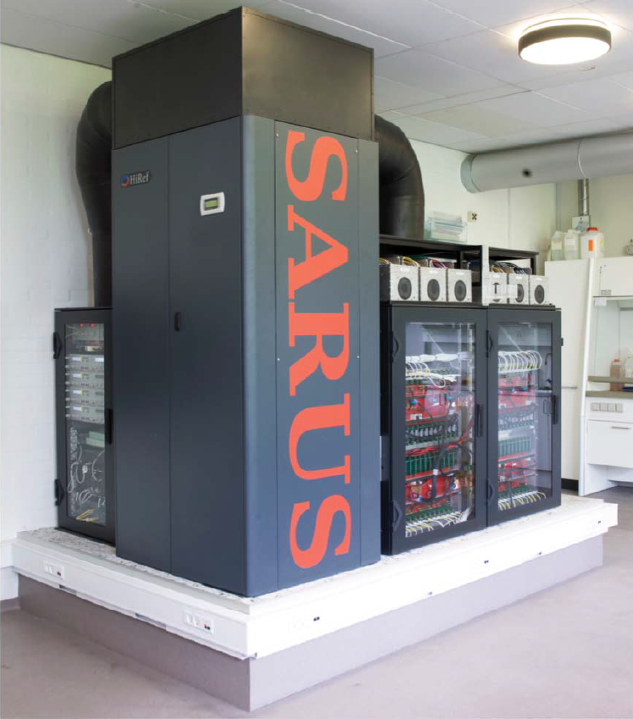
Historical review of Ultrasound Open Platforms
Array Systems With Full TX and RX Control
2005: The first OP with real-time TX and RX control of the entire array was the Remotely Accessible Software configurable Multi-channel Ultrasound Sampling (RASMUS) system
waveforms could be transmitted on up to 128 channels in parallel,
data could be sampled at 40 MHz and 12-bit resolution for 64 channels in parallel and stored in 16 GB of RAM.
2010: The second generation of the Danish system called SA realtime ultrasound system (SARUS)
can send out arbitrary coded signals on all 1024 channels and can receive simultaneously on all channels,
data can be stored in the 128-GB RAM, 320 FPGAs in the system.

Slide 14
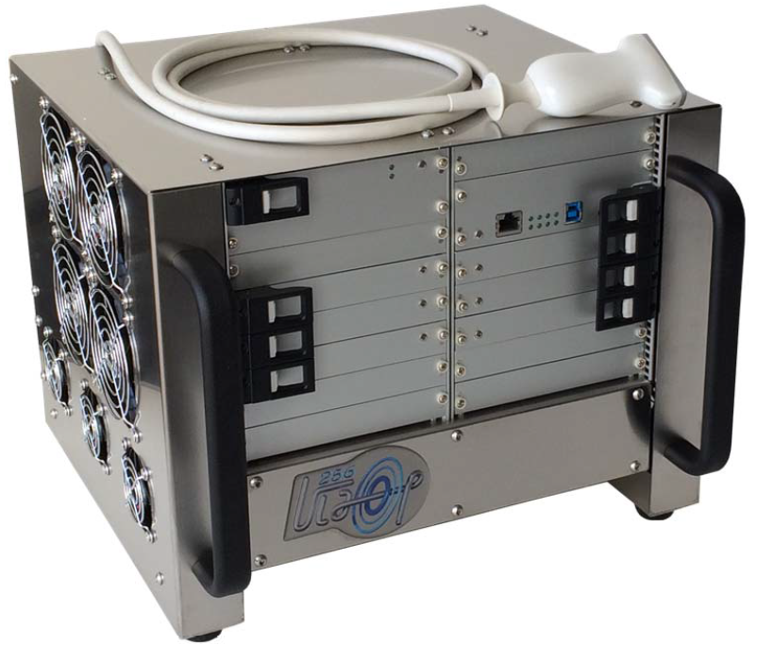
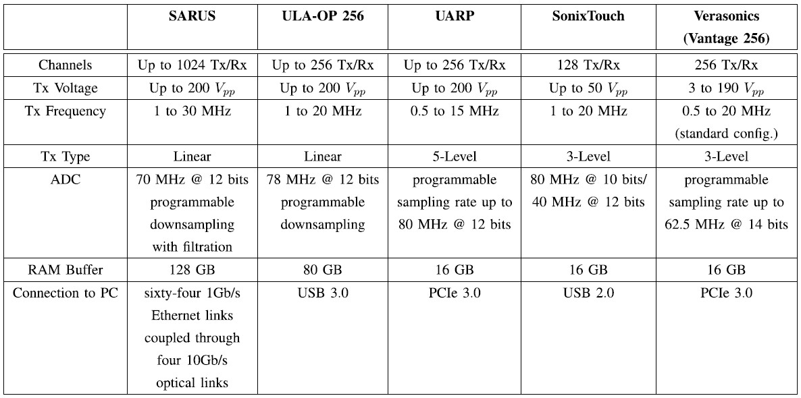
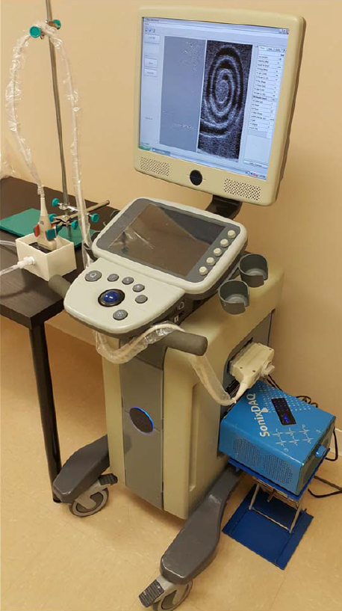
Historical review of Ultrasound Open Platforms
Open Platforms With Transportable Size
Commercial Systems for Research Purpose

Slide 15
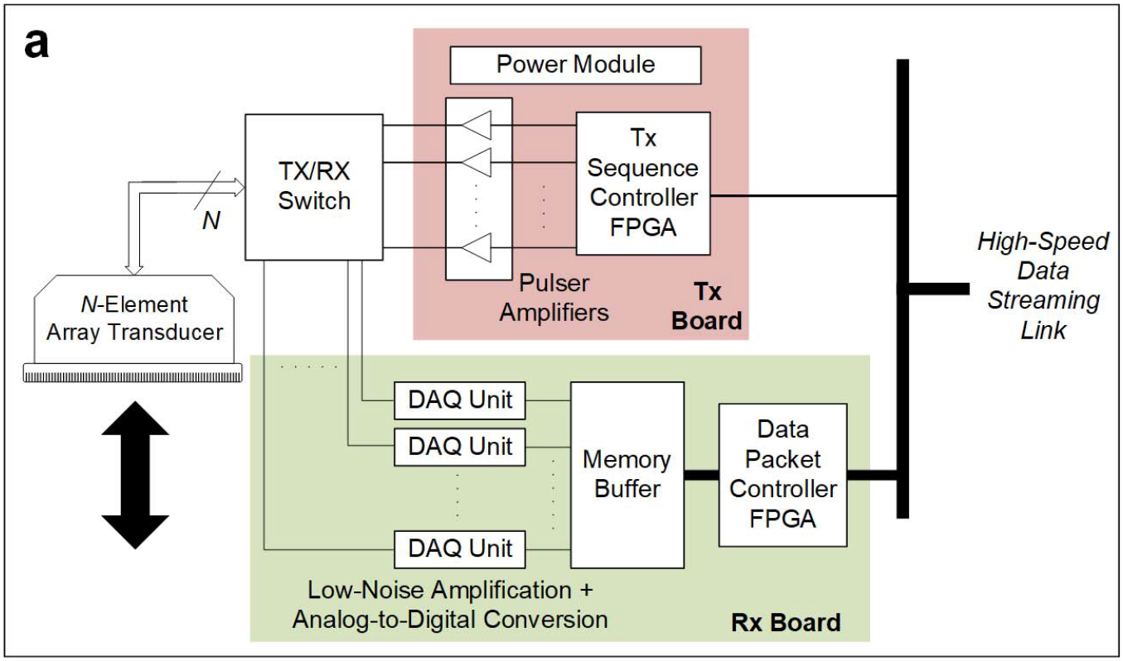
Architecture of Open Platforms: Software-Based Platforms
OP scanners that implement data processing routines through computer programming
Front-End Electronics

Slide 16
Architecture of Open Platforms: Software-Based Platforms
Data Streaming
software-based OPs do not have a hardware beamformer, nor on-board computing devices
all the acquired channel data are fed to the computing back-end for processing
the data handling strategy necessitates the use of a high-speed data streaming link
data transfer links with high bandwidth are typically deployed in software-based OPs:
multiple PCIe links
PCIe hardware switch is deployed to facilitate the direct streaming of data packets to back-end computing devices

Slide 17
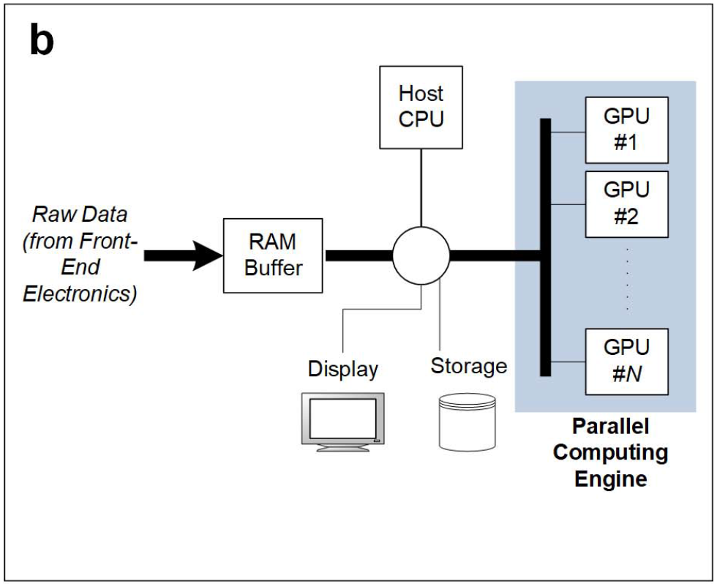
Architecture of Open Platforms: Software-Based Platforms
Back-End Computing Engine
responsible for executing the entire signal processing chain that regards raw channel data frames as its input.
GPU has been leveraged as an enabling technology to facilitate high-throughput parallel processing of raw data samples

Slide 18
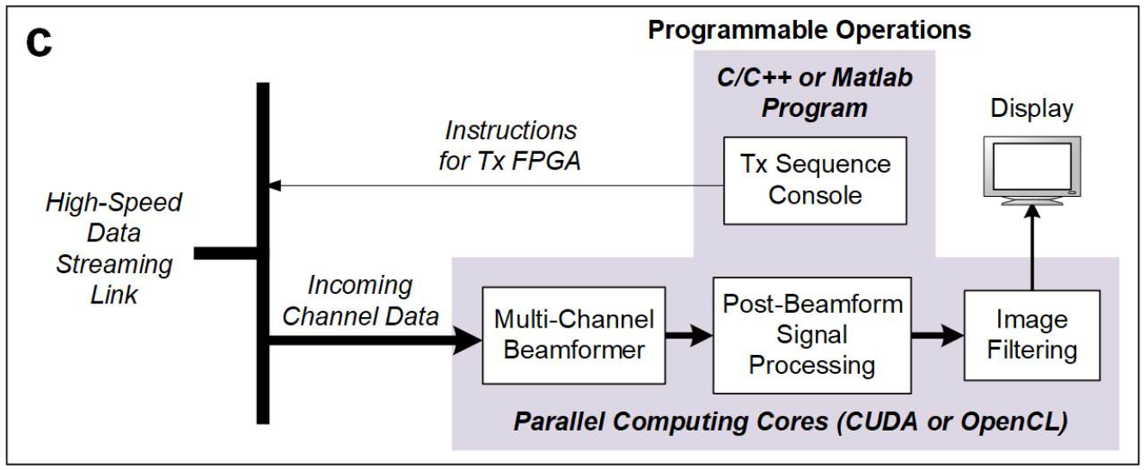
Architecture of Open Platforms: Software-Based Platforms
Programmability of System Operations

Slide 19
Architecture of Open Platforms: Software-Based Platforms
Software-based OPs offer researchers the convenience of using C/C++ or MATLAB to prototype new signal processing methods that work with raw channel data.
The savings in development time effectively serve to accelerate the pace of development for new ultrasound imaging techniques.

Slide 20
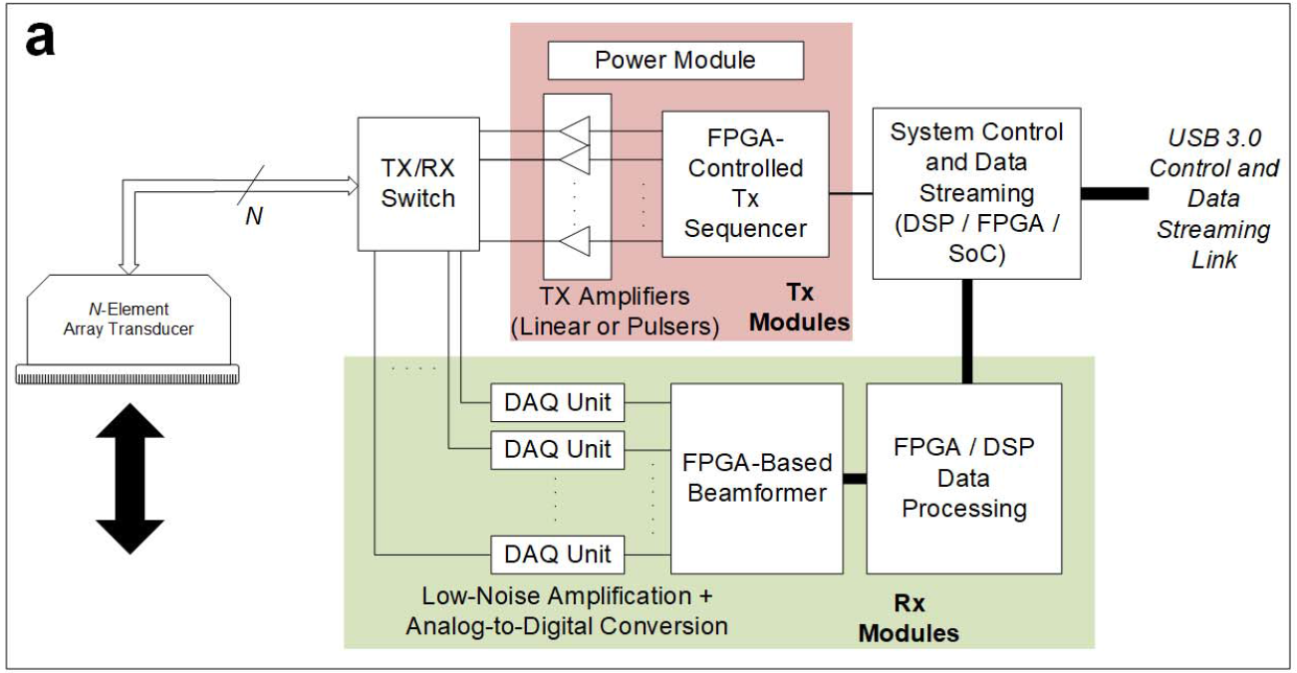
Architecture of Open Platforms: Hardware-Based Platforms
OP scanners that realize data processing via on-board computing hardware such as FPGA, digital signal processor (DSP), and system on chip (SoC)
General System
Organization

Slide 21
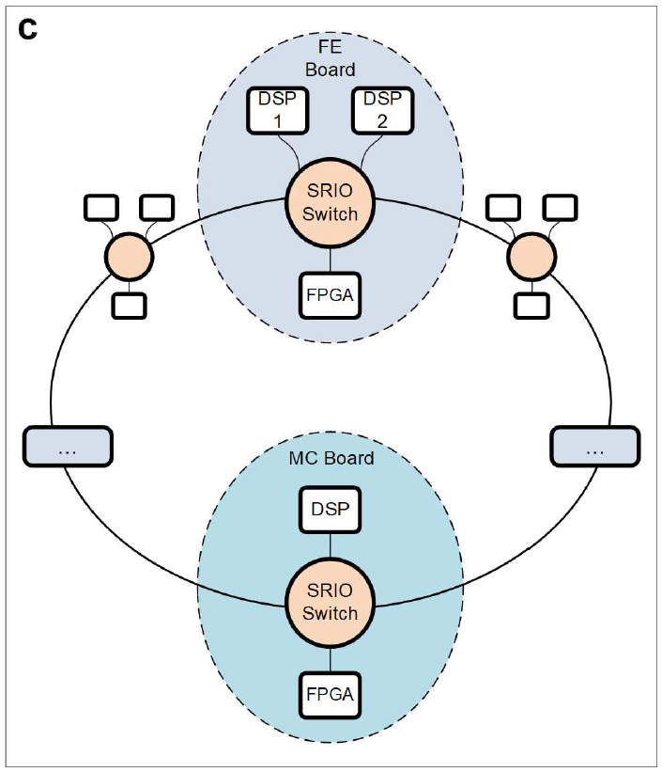
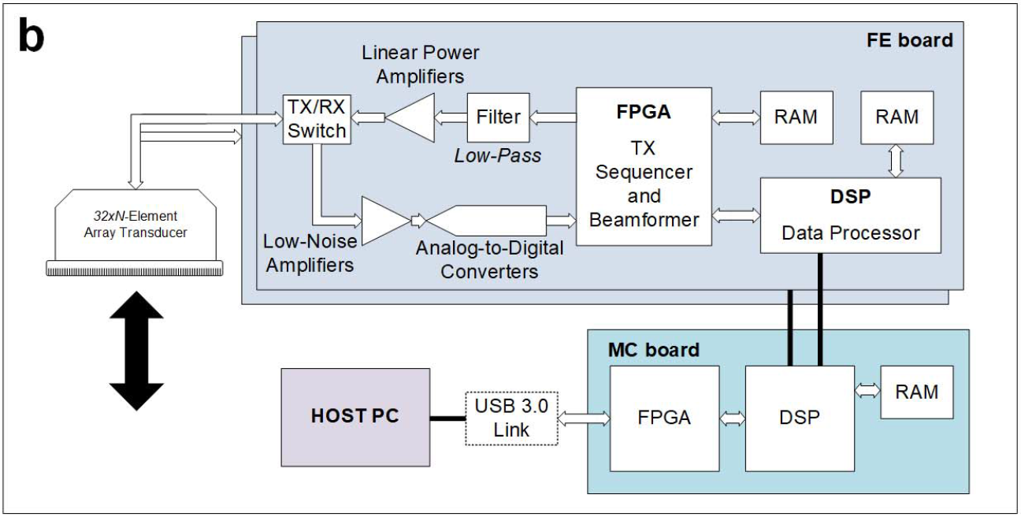
Architecture of Open Platforms: Hardware-Based Platforms
Hardware Architecture
A hardware-based OP may be devised using a modular design approach to effectively facilitate the scaling of system complexity in terms of both PCB design and programmability.

Slide 22
Architecture of Open Platforms: Hardware-Based Platforms
Data Acquisition and On-Board Processing
On the RX side, the raw channel echoes are relayed to four 8-channel ultrasound FE ICs, where they are amplified and are digitized
The digitized data streams are sent to the FPGA and are stored in a RAM storage buffer
Each FE board during its TX operation would generate 32 independent arbitrary signals
After FPGA beamforming, the output data may be passed to the two on-board DSPs
The FPGA on each FE board can be programed to perform different beamforming strategies on 32 channels
DSPs are leveraged to perform coherent compounding of RF data or demodulate the RF data into quadrature channels, and then perform low-pass filtering and down sampling to derive the corresponding baseband data
Each FE board’s processor output is sent to the MC board through the ring topology
MC board’s DSP would correspondingly sum the intermediate data samples from different FE boards to obtain the final beamformed (or baseband) data sample for each pixel position in the image grid

Slide 23
Architecture of Open Platforms: Hardware-Based Platforms
Programmability of System Operations
Similar to software-based OPs, the TX and RX operations of hardware-based OPs may be programed by the user
For RX data processing, the user can configure real-time code modules that are provided within the firmware package
The configuration of these prebuilt modules is described by text files that define, for each PRI, the data to be elaborated and the parameters related to the instantiated module.

Slide 24
Open Platforms With Extended Number of Channels
The investigation of 3-D imaging and advanced beamforming necessitates the development of research systems with a very high channel count (>256 channels).
Standalone Systems
The first OP with more than 256 channels is the SARUS scanner which comprises 1024 independent TX and RX:
All 1024 channels can be used simultaneously or the system can be split into four independent system, which can be used at the same time on four experiments

Slide 25
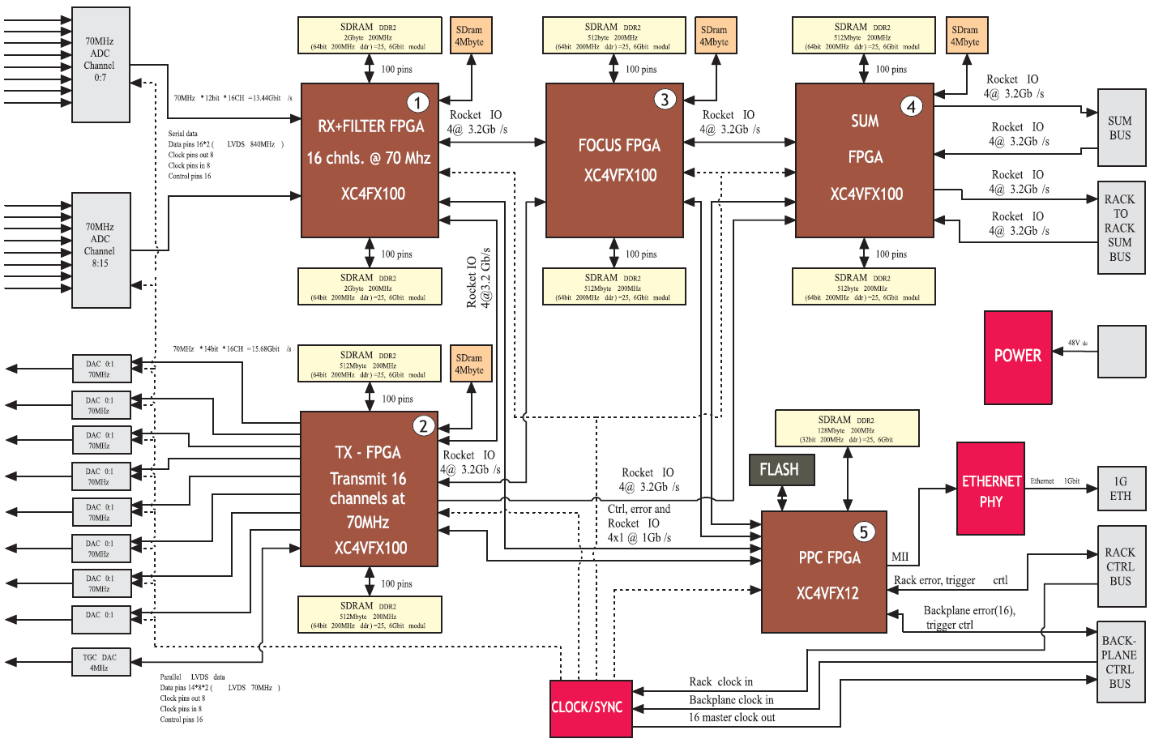
Open Platforms With Extended Number of Channels
Block diagram of the FE board in the SARUS system

Slide 26
Open Platforms With Extended Number of Channels
Composite Platforms via Multisystem Synchronization
A possible extension of channel count could be achieved by the use of multiplexers interposed between the scanner and the probe
One viable alternative is to connect together more systems in attempt to control all array elements concurrently.
ULA-OP 256 was designed with embedded synchronization capabilities. One master system can directly feed up to four slave systems with proper acquisition clock and synchronization signals
Such a composite platform assembly strategy unavoidably brings synchronization issues, since forcing different discrete systems to run on the same clock is not trivial

Slide 27
Discussion
General Comparison of Open Platforms
Important technical attributes:
1) Its TX operations should be programmable on a perchannel basis.
2) Prebeamform RX data should be accessible over all transducer channels, and a significant amount of RAM is available to store the data samples from multibeat acquisition.
3) Abundant computing resources should be included to allow real-time implementation of new data processing methods.
These attributes are nowadays included in either hardware- and software-based OPs.

Slide 28
Discussion
General Comparison of Open Platforms
Open Platforms | Required knowledge | Real-time | Important feature
Software-based OPs | work with since their user-level programing environment, does not require knowledge of low-level hardware description languages | the design of parallel processing kernels requires some level of craftsmanship in order to optimize their processing performance | A important feature shared by different types of ultrasound OPs is that they possess tens and hundreds of gigabytes of RAM to store full RF data frames over multiple heart beats
Hardware-based OPs | must be proficient in both low-level programming languages，high-level languages and system architecture | suited for real-time applications, because the data transfer issue is reduced considerably

Slide 29
Discussion
Future Trends of Open Platforms
The demand for more advanced OPs with an extended number of channels is poised to grow
Faster data transmission technology is well possible to be adopted in next-generation OP systems
As more convoluted imaging algorithms are being developed, it would be worthwhile to pursue a hardware–software hybrid computation approach that combines the strengths of GPU, FPGA, and DSP to implement these algorithms in real time
System design partitioning will likely become a significant engineering topic of interest for real-time realization of the next-generation ultrasound imaging methods

Slide 30
Conclusion
Thanks to the increasing maturity of OP ultrasound scanners, the research community is now entering another golden age where researchers are actively proposing a variety of new imaging methods and algorithms
Rapid progress in electronics and computer science is driving the next wave of OP development with high-speed, small-size ICs for both acquisition and processing, a significant amount of RAM resources as well as high-level programming of sophisticated TX–RX strategies
It is well anticipated that the performance of upcoming OPs will further increase in terms of processing power, flexibility, and ease of programming
In turn, these next-generation OPs will undoubtedly accelerate the pace of advancement in ultrasound imaging technology

Slide 31
THANKS!

